Slide 1


The synthesis of complex audio spectra by means of Frequency Modulation
Matteo Malucchi
Thesis supervisor: Marco Sozzi
Physics Department “Enrico Fermi”
University of Pisa
Academic year 2020/2021
The synthesis of complex audio spectra by means of frequency modulation

Slide 2
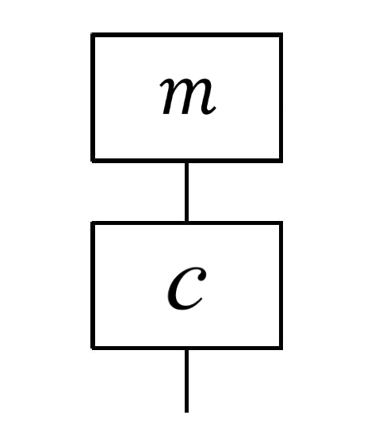
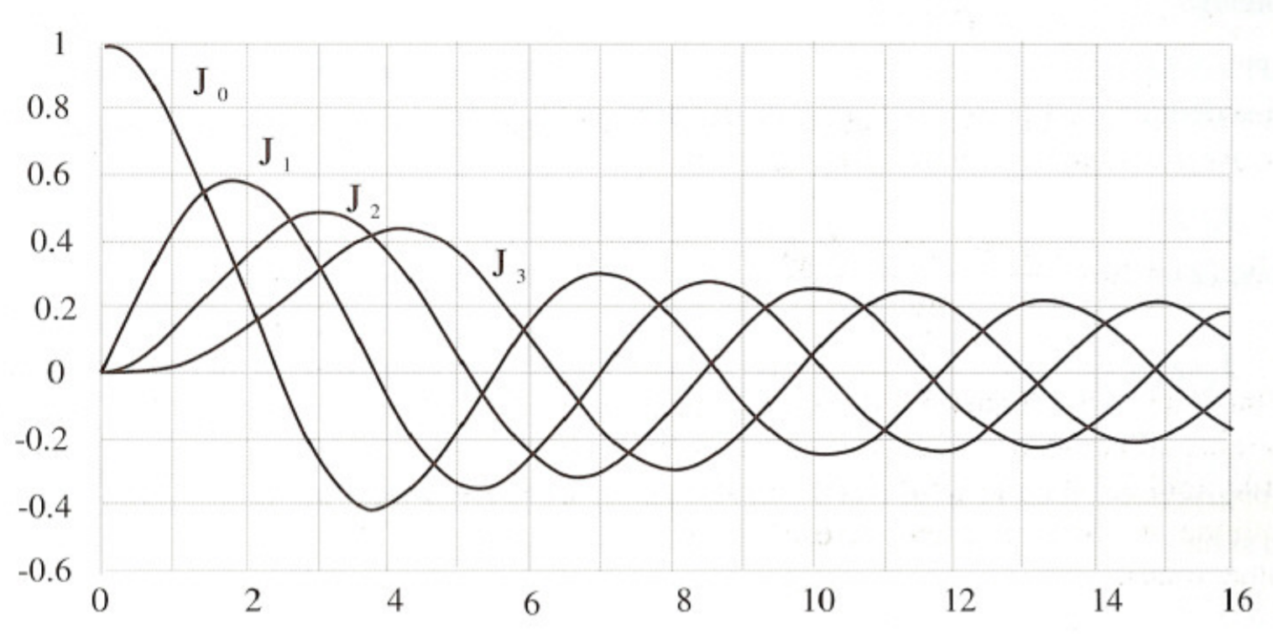
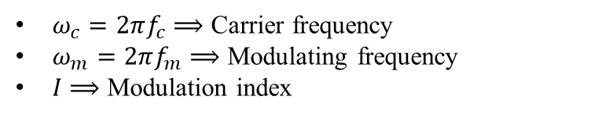
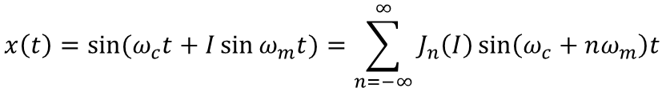
Fundamentals of Frequency Modulation synthesis
Frequency Modulation (FM) synthesis is a technic that allows to generate complex audio spectra by varying the instantaneous frequency of a carrier wave (c) according to a modulating wave (m), such that the rate at which the carrier varies is the frequency of the modulating wave as show below.
$$x\left(t\right)=\sin{{(ω}_{c}t+I\sin{ω_{m}t})=\sum_{n=−∞}^{∞}{J_{n}\left(I\right)\sin\left(ω_{c}+nω_{m}\right)t }}$$
$ω_{c}=2πf_{c}$ $⟹$ Carrier frequency
$ω_{m}=2πf_{m}⟹$ Modulating frequency
$I$ $⟹$ Modulation index
$J_{n}\left(I\right)={\left(\frac{I}{2}\right)}^{n}\sum_{h=0}^{∞}{\frac{{(−1)}^{h}}{h!(n+h)!}{\left(\frac{I}{2}\right)}^{2h}} ⟹$ Bessel function of the first kind and nth order
The synthesis of complex audio spectra by means of frequency modulation

Slide 3
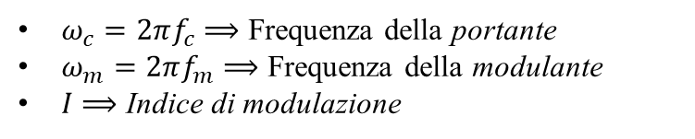
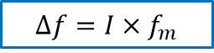
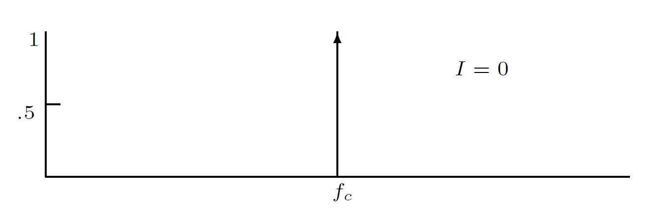
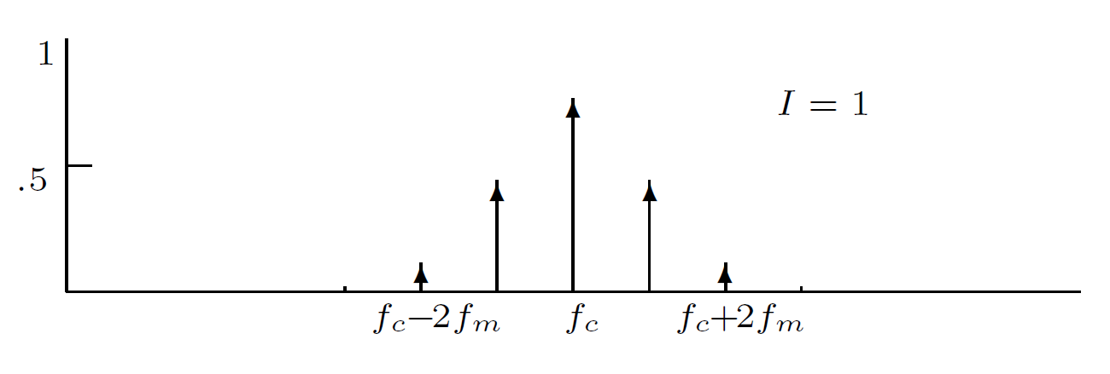
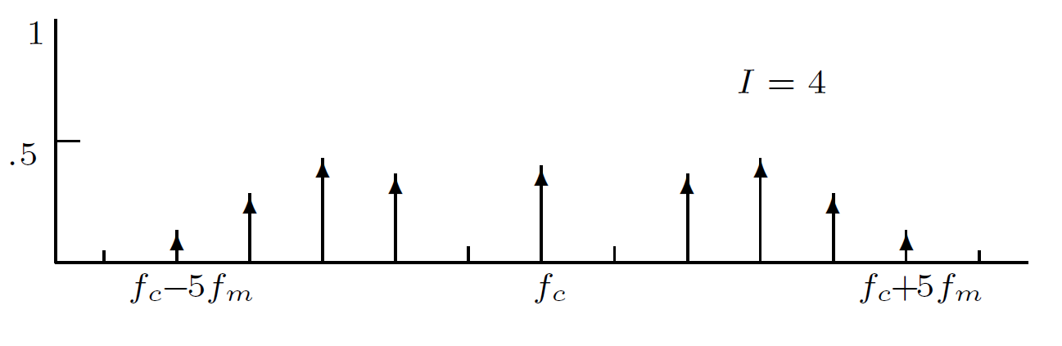
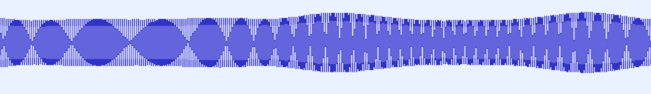

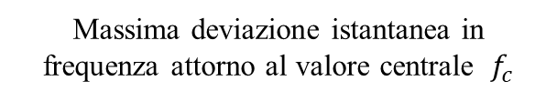
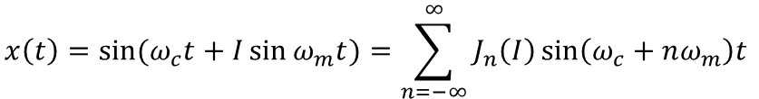
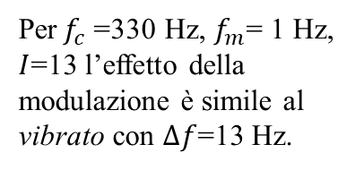
Fondamentals of FM synthesis
La sintesi FM consiste nel modificare la frequenza di un segnale audio, la portante $(c)$ , con un'altra onda, la modulante $(m)$, così da ottenere un timbro dallo spettro complesso.
$$x\left(t\right)=\sin{{(ω}_{c}t+I\sin{ω_{m}t})=\sum_{n=−∞}^{∞}{J_{n}\left(I\right)\sin\left(ω_{c}+nω_{m}\right)t }}$$
$ω_{c}=2πf_{c}$ $⟹$ Frequenza della portante
$ω_{m}=2πf_{m}⟹$ Frequenza della modulante
$I$ $⟹$ Indice di modulazione
$J_{n}\left(I\right)={\left(\frac{I}{2}\right)}^{n}\sum_{h=0}^{∞}{\frac{{(−1)}^{h}}{h!(n+h)!}{\left(\frac{I}{2}\right)}^{2h}} ⟹$ Funzione di Bessel del primo tipo di ordine n
Massima deviazione istantanea in frequenza attorno al valore centrale ${ f}_{c}$
Per${ f}_{c}$=330 Hz, $f_{m}$= 1 Hz, $I$=13 l’effetto della modulazione è simile al vibrato con $∆f$=13 Hz.
$$∆f=I×f_{m}$$
The synthesis of complex audio spectra by means of frequency modulation

Slide 4
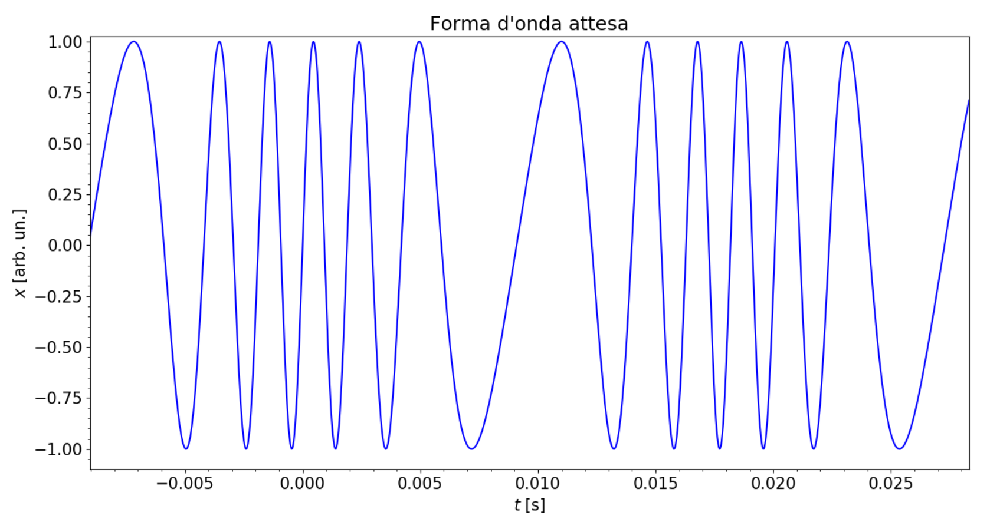
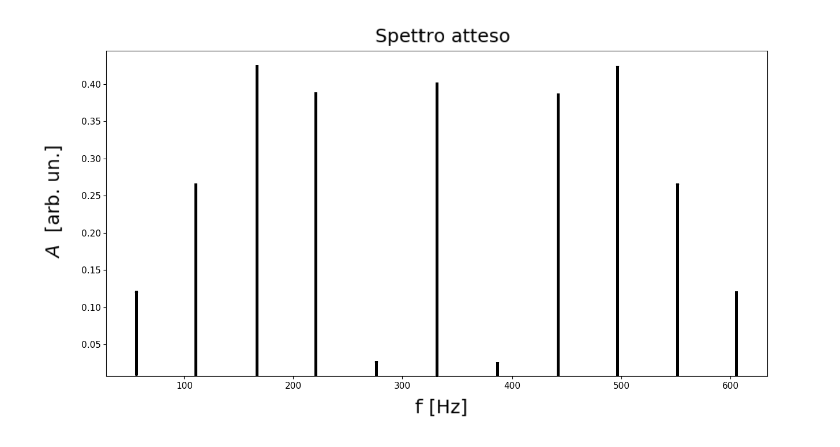
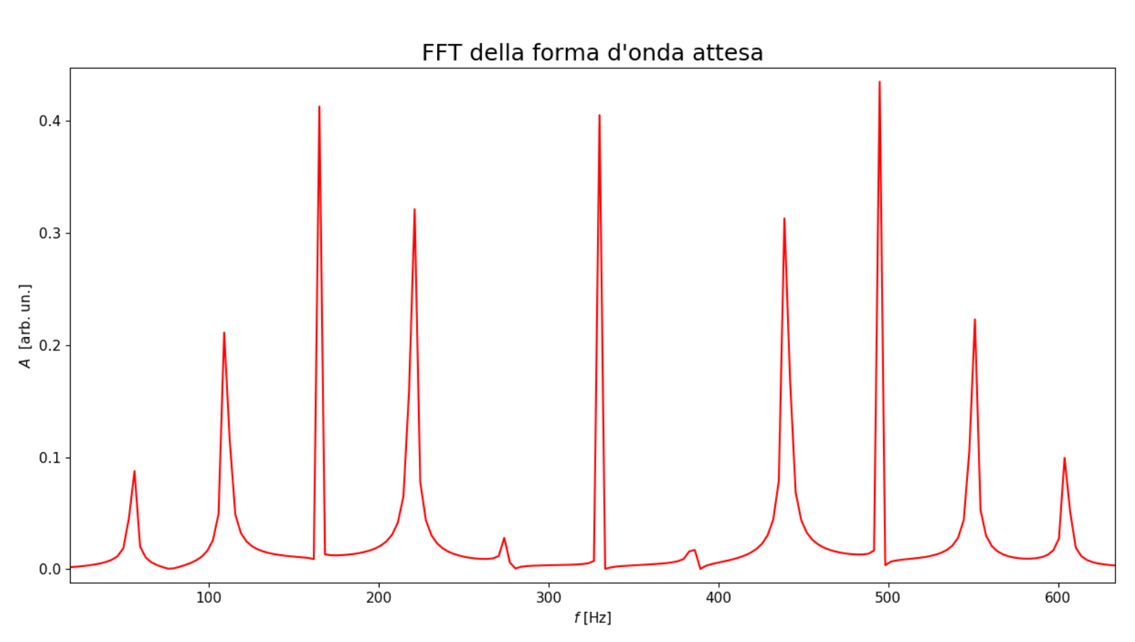
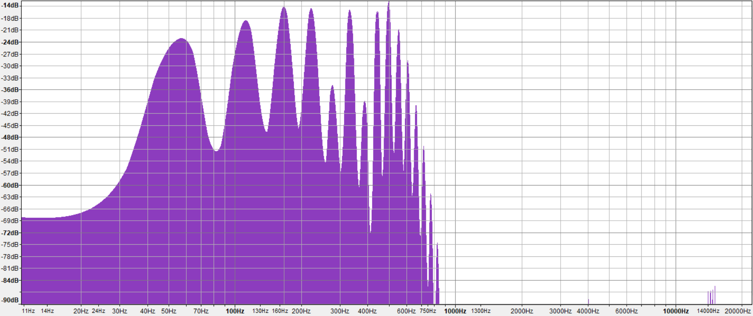

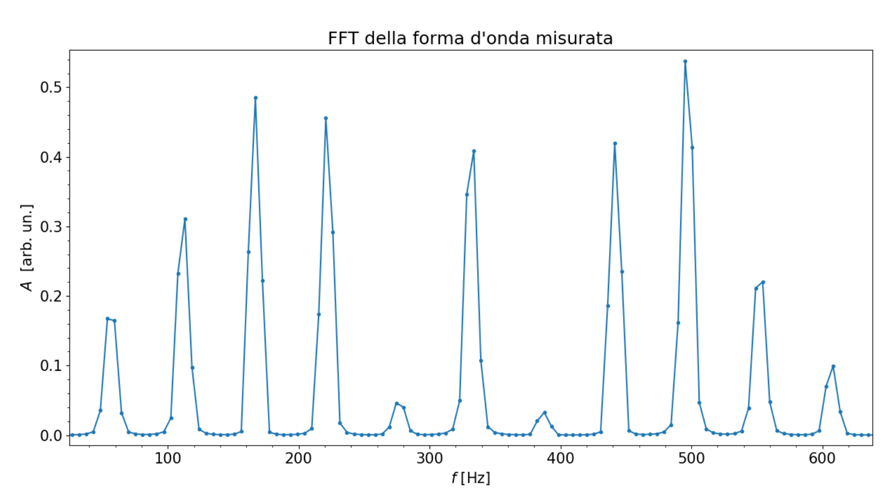
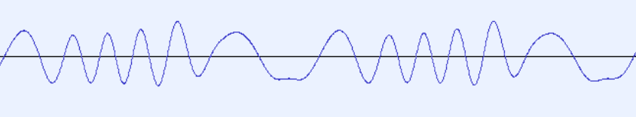
Simple FM
Esempio di un segnale di frequenza $f_{c}$=330 Hz modulato da un’onda di frequenza $f_{m}$= 55 Hz con $I$=3.9
The synthesis of complex audio spectra by means of frequency modulation

Slide 5
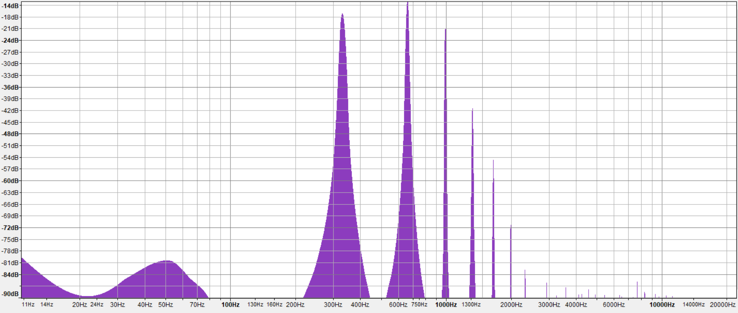
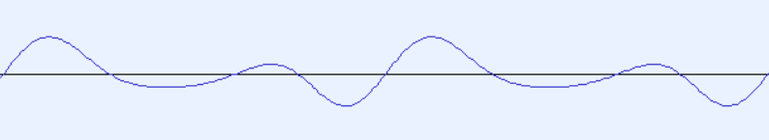
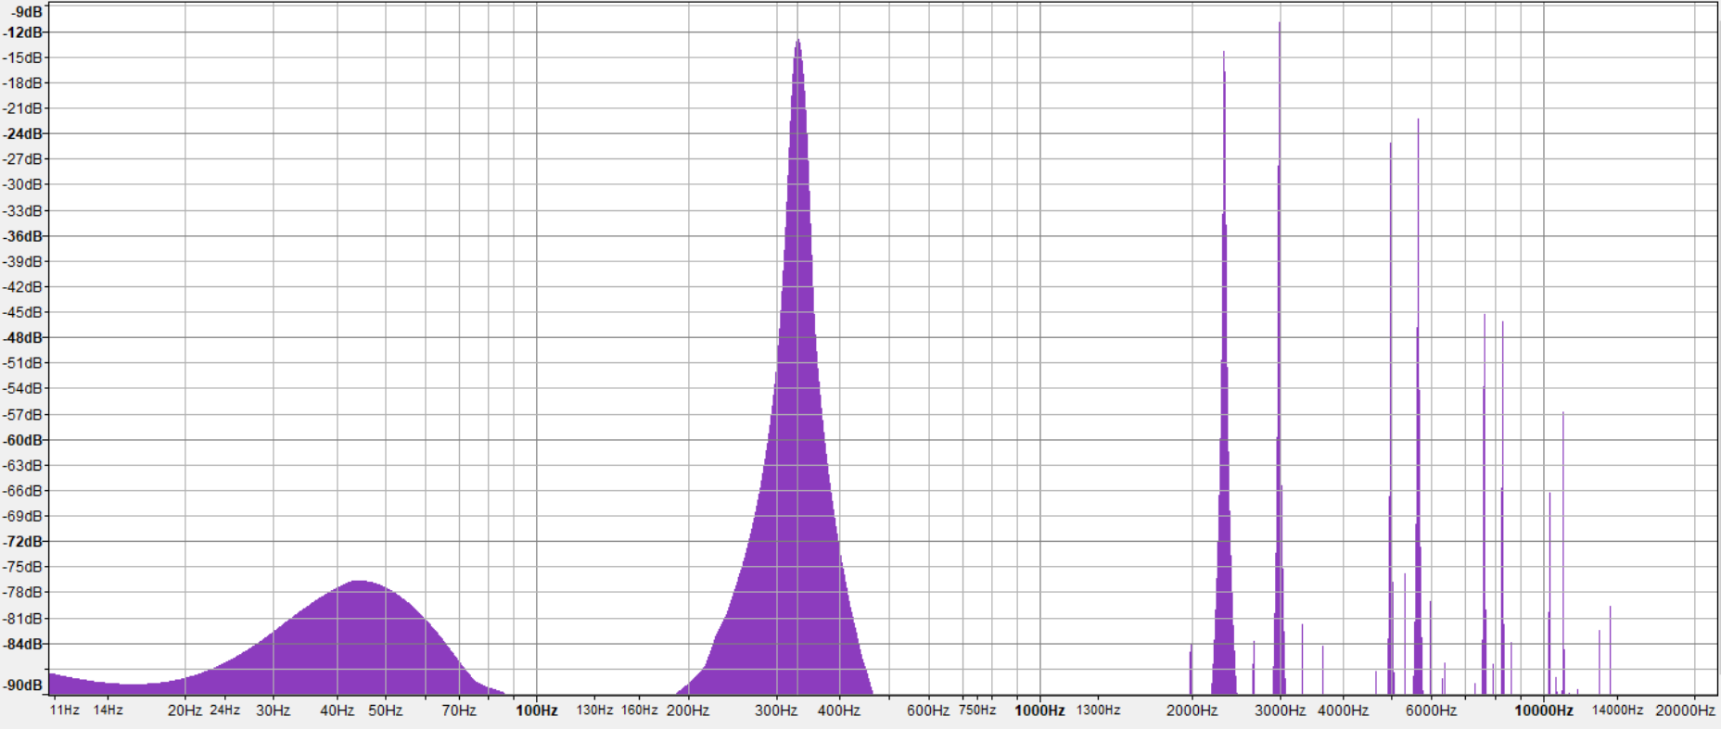
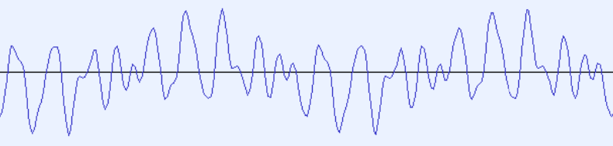
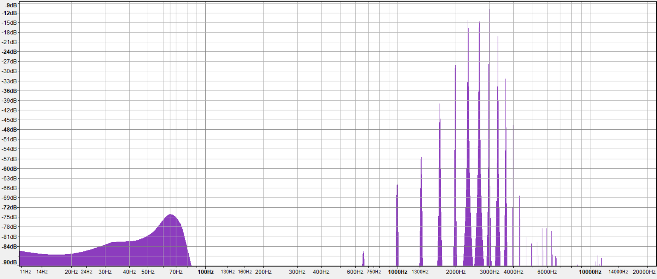
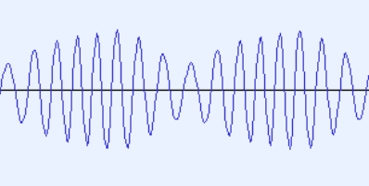
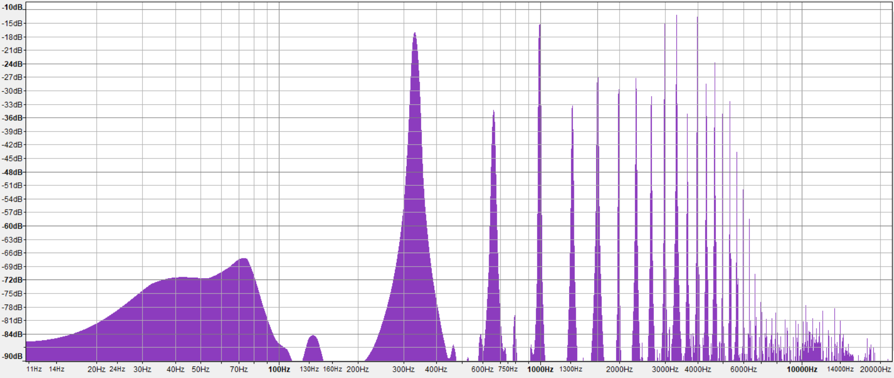
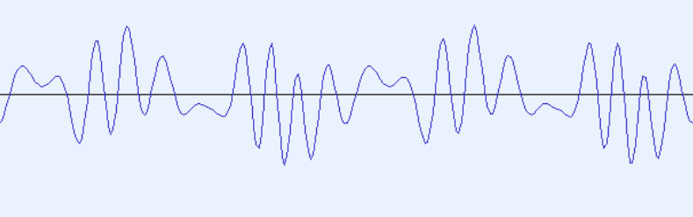

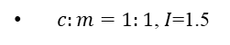

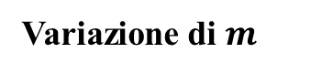
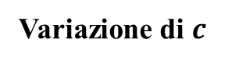
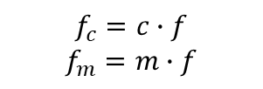
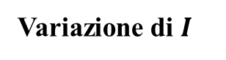
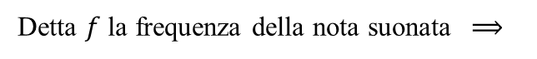
Spettro armonico e dipendenza dai vari parametri
Detta $f$ la frequenza della nota suonata $⟹$
$$f_{c}=c∙f$$
$$f_{m}=m∙f$$
Se $c:m=N_{1}:N_{2} (N_{1}$, $N_{2}$numeri interi piccoli$)⟹Lo s$pettro è armonico
Variazione di $m$
$c:m=1:1$, $I$=1.5
$c:m=1:8$, $I$=1.5
Variazione di $c$
Variazione di $I$
$c:m=8:1$, $I$=1.5
$c:m=1:1$, $I$=13
The synthesis of complex audio spectra by means of frequency modulation

Slide 6
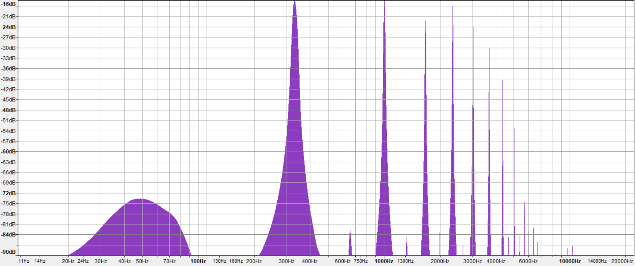
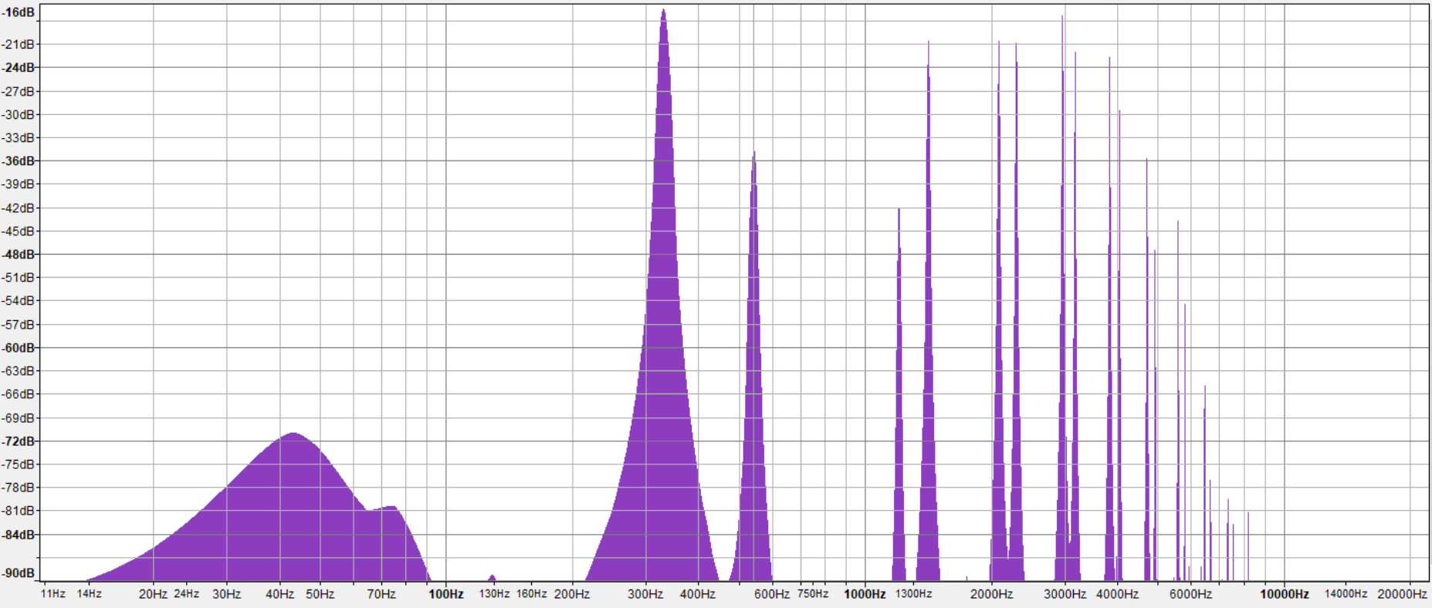


Spettro inarmonico
Se $c:m≠N_{1}:N_{2} ⟹$ Lo spettro è inarmonico
$c:m=1:2.02$, $I$=4
$c:m=1:2.64$, $I$=4
The synthesis of complex audio spectra by means of frequency modulation

Slide 7
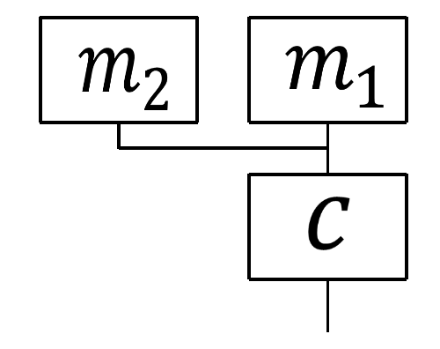
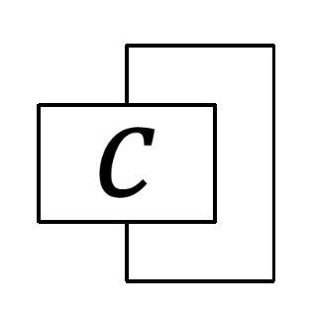
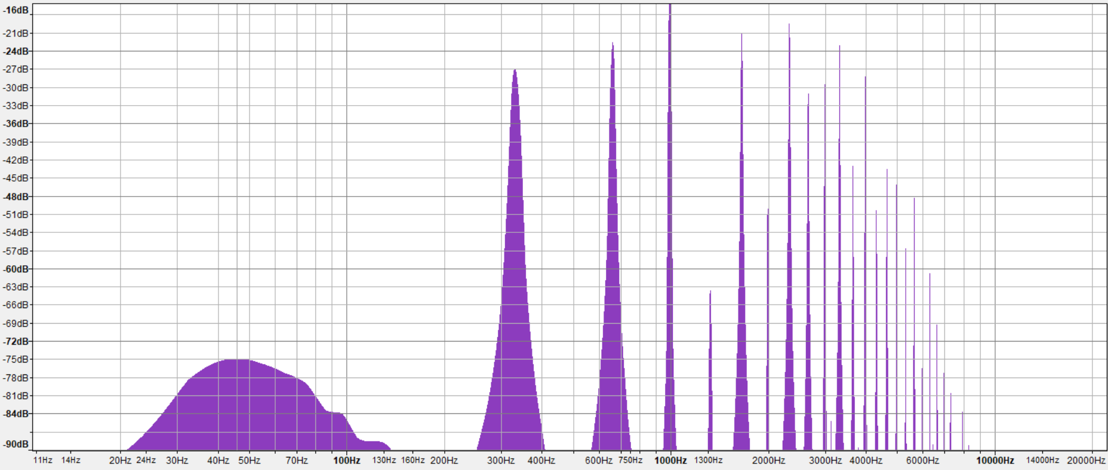
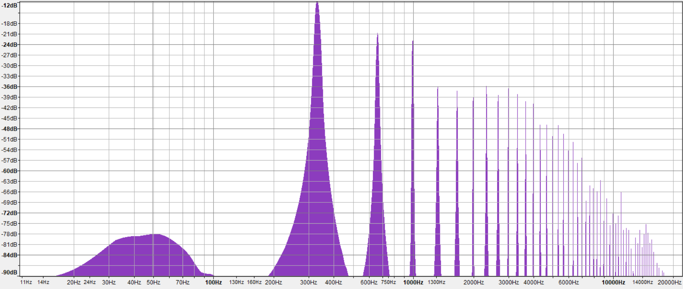
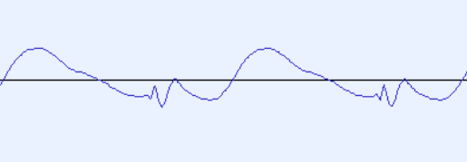
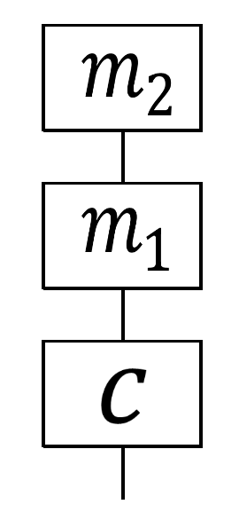
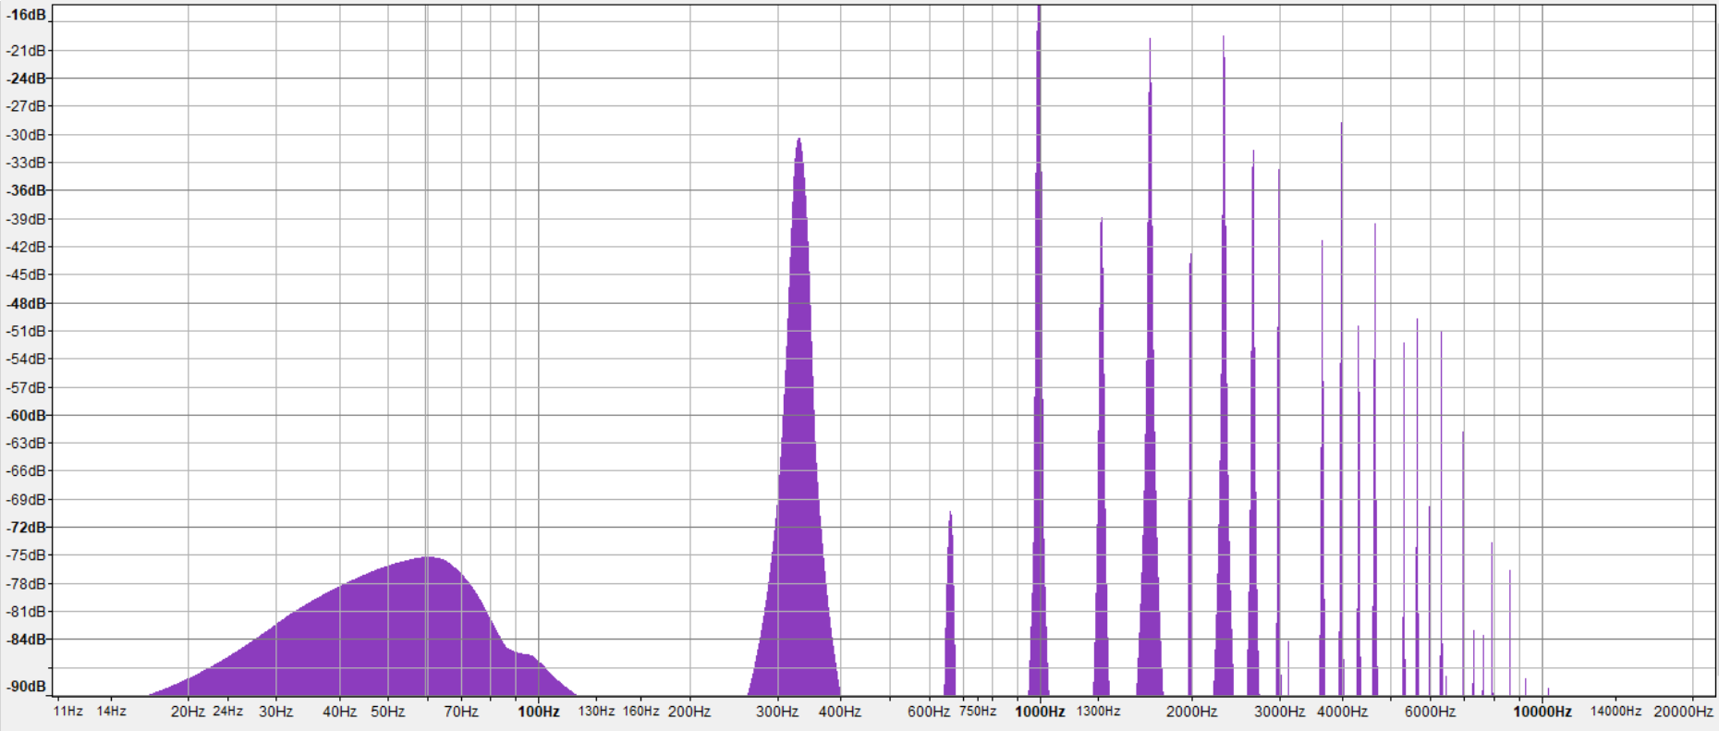
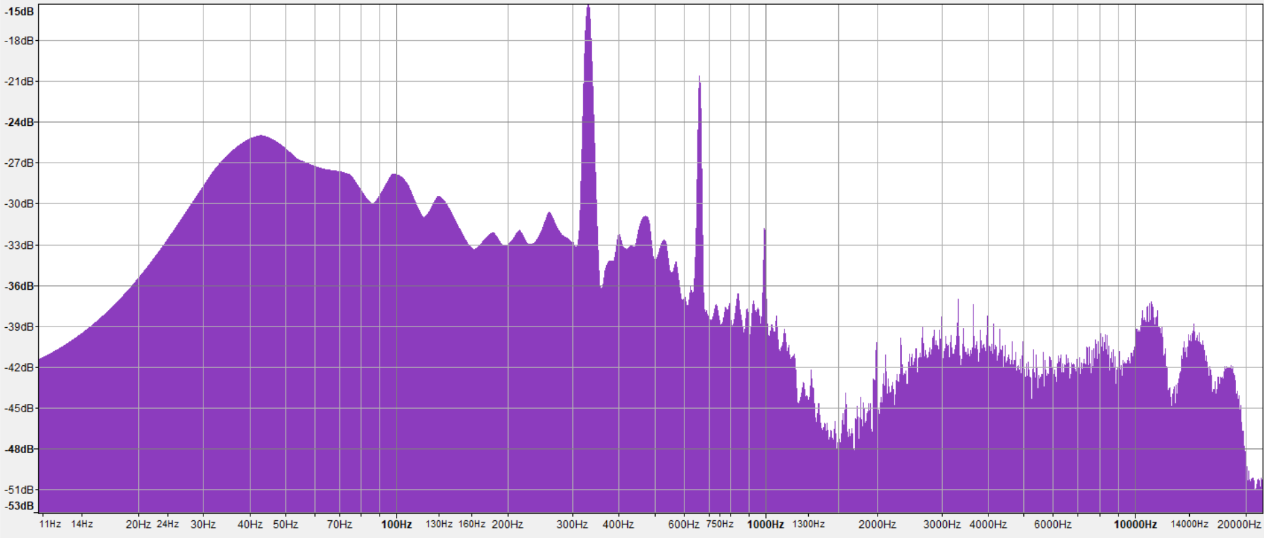
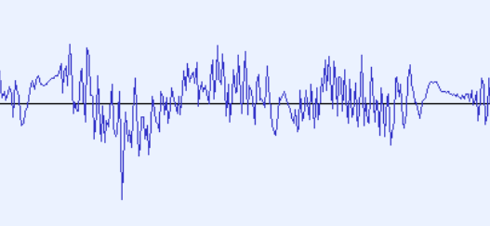
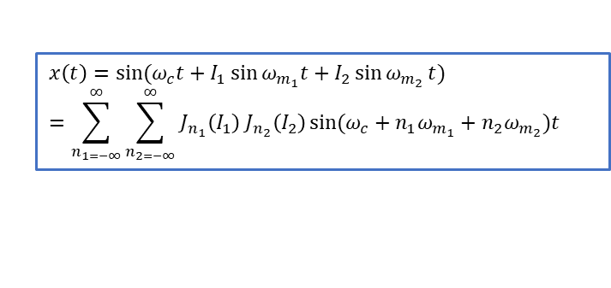

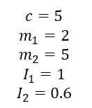
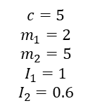
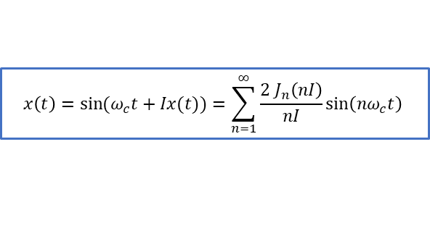

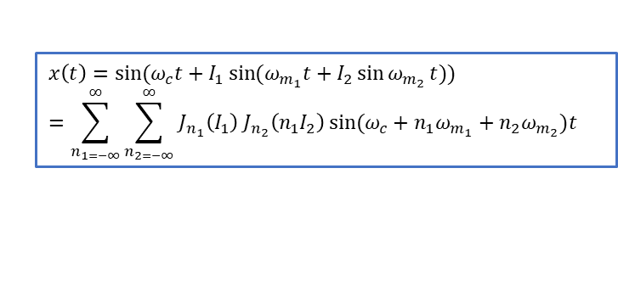
Complex FM
Esempi di altre configurazioni più complesse che permettono di generare spettri ricchi di armoniche.
Modulatori in parallelo
Feedback
$$x\left(t\right)=sin⁡(ω_{c}t+I_{1}\sin{ω_{m_{1}}t}+I_{2}\sin{ω_{m_{2}}}t)=\sum_{n_{1=−∞}}^{∞}{\sum_{n_{2=−∞}}^{∞}{J_{n_{1}}\left(I_{1}\right) J_{n_{2}}\left(I_{2}\right)}}sin⁡(ω_{c}+n_{1}ω_{m_{1}}+n_{2}ω_{m_{2}})t$$
$$x\left(t\right)=\sin{{(ω}_{c}t+Ix(t))=\sum_{n=1}^{∞}{\frac{2 J_{n}\left(nI\right)}{nI}\sin\left({nω}_{c}t\right) }}$$
$$c=5$$
$$m_{1}=2$$
$$m_{2}=5$$
$$I_{1}=1$$
$$I_{2}=0.6$$
$c=m=1, I=1$
Modulatori in cascata
$$x\left(t\right)=sin⁡(ω_{c}t+I_{1}\sin{(ω_{m_{1}}t}+I_{2}\sin{ω_{m_{2}}}t))=\sum_{n_{1=−∞}}^{∞}{\sum_{n_{2=−∞}}^{∞}{J_{n_{1}}\left(I_{1}\right) J_{n_{2}}\left(n_{1}I_{2}\right)}}sin⁡(ω_{c}+n_{1}ω_{m_{1}}+n_{2}ω_{m_{2}})t$$
$c=m=1, I=13$
$$c=5$$
$$m_{1}=2$$
$$m_{2}=5$$
$$I_{1}=1$$
$$I_{2}=0.6$$
The synthesis of complex audio spectra by means of frequency modulation

Slide 8
References
John Chowning, David Bristow, "FM Theory & Applications - By Musicians For Musicians", Tokyo, Yamaha, 1986, ISBN 4-636-17482-8.
Dave Benson, "Music: A Mathematical Offering", Cambridge University Press, 2006, ISBN 9780511811722.
J. Chowning, "The Synthesis of Complex Audio Spectra by Means of Frequency Modulation", in Journal of the Audio Engineering Society, vol. 21, n. 7, 1973.
Roads, Curtis, "The Computer Music Tutorial", MIT Press, 1996, ISBN 978-0-262-68082-0.
Programs used for the making of the various spectra
Dexed: https://www.kvraudio.com/product/dexed-by-digital-suburban
Audacity: https://www.audacityteam.org
Python: https://www.python.org
The synthesis of complex audio spectra by means of frequency modulation

